Slide 1
MINI PROJECT REVIEW-2
Status of project completion
Proposed algorithm
Partial Output
Project guide : Mrs. r. aruna flarence
Members:
M. S. HARSHA VARDHAN REDDY 17241A0533
MOHAMMED ABDUS SAMEE 17241A0534
KARTHIK SURESH 17241A0523

Slide 2
Objective of Project
To predict the climate change
To visualize the temperature details of various regions
PROBLEM STATEMENT
This Product determines whether the place is affected by climate change or not

Slide 3
Modules of the project
Time series analysis using various regression techniques
The whole setup is developed on Flask based web application
The web pages are styled using Bootstrap which contains predefined CSS classes.

Slide 4
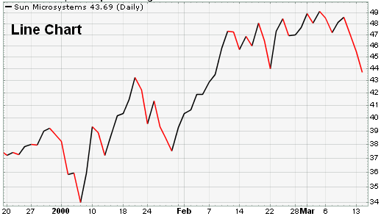
Project Architecture
Train the Regression algorithm
Data Set
Test the given input with the algorithm
Give an input to test the algorithm
Study the problem
Analyse the errors
Evaluate the Solution
Display the solution
False
True

Slide 5
Status of project completion
Finding the data for processing
Extracting data to train and test the model
Designing an algorithm to extract the required fields from data
Plotting graph based on the data
Designed 2 of the 5 algorithms to predict the output

Slide 6
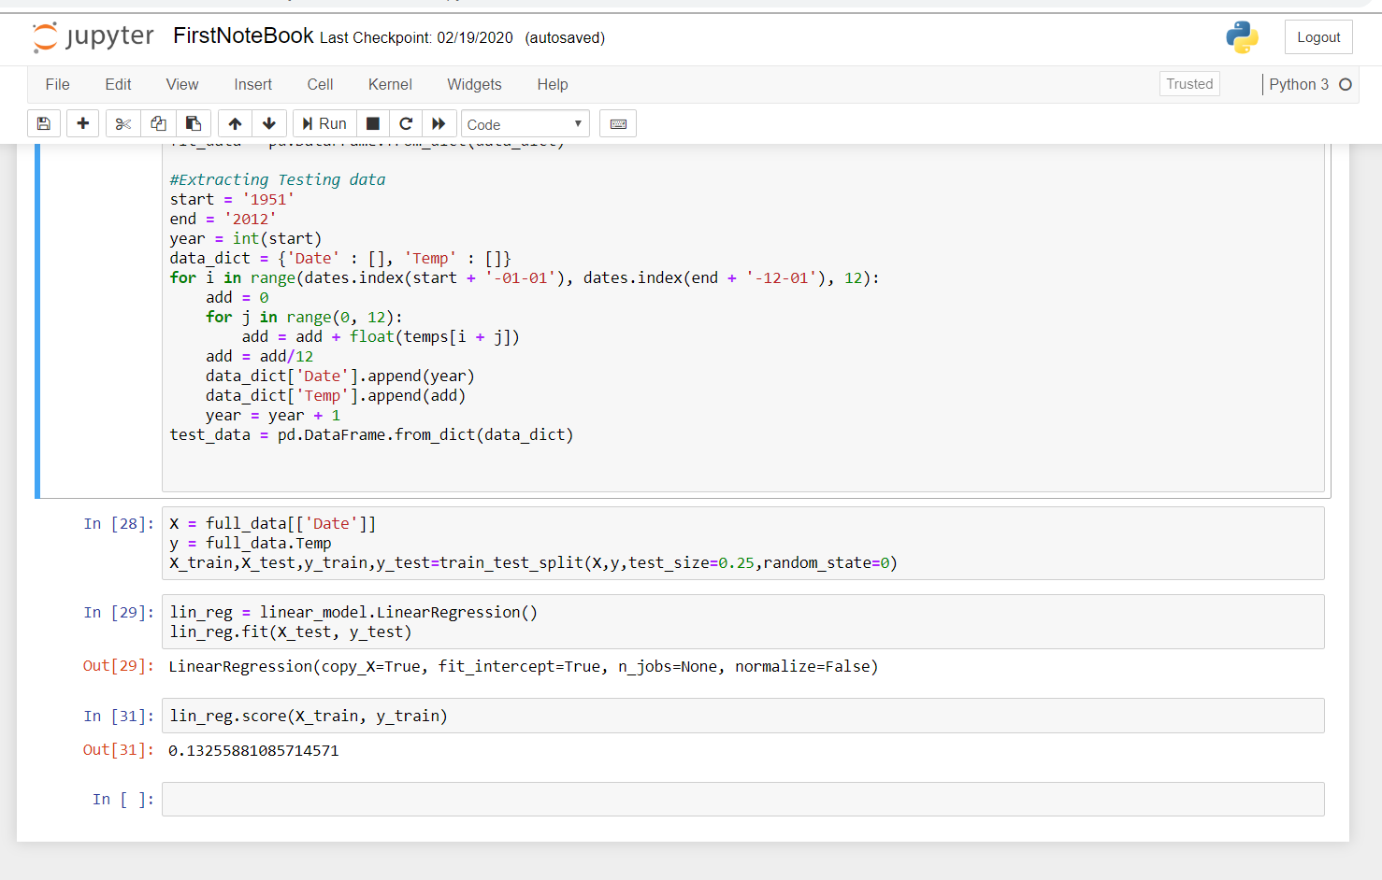
Proposed algorithm

Slide 7
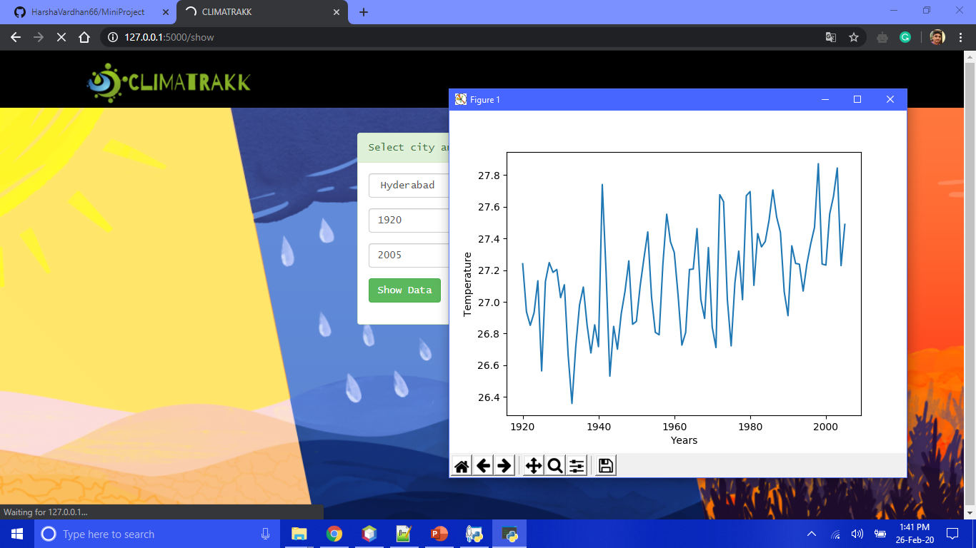
Partial Output - 1

Slide 8
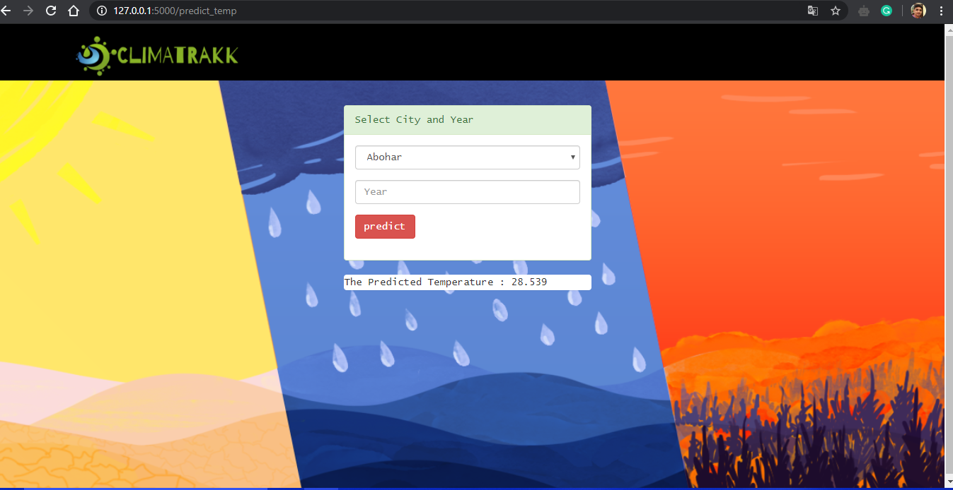
PARTIAL OUTPUT - 2

